Slide 2

Is anyone here a road tripper?
Notes:
Ah the great road trips of the past, poor air conditioning
No clue where you were
Only knowing the current location when you could find a mile marker

Slide 3
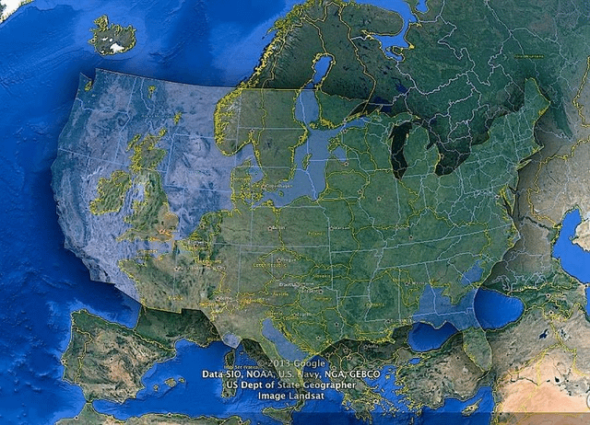
Total around 2,919 miles / 3,525 km
45 hours of driving

Slide 4


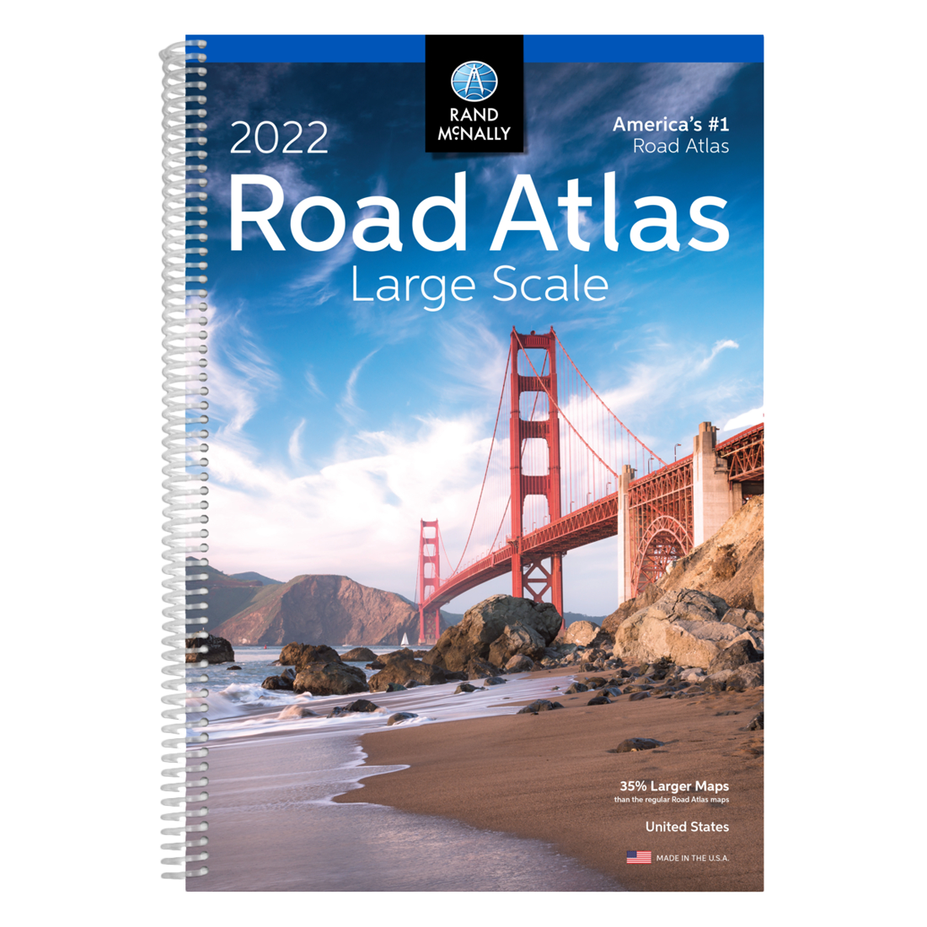


Notes:
Common Frustrations
Had to ask the navigator for updates
Which means she had to be awake the entire time

Slide 5

ARE WE THERE YET?
Defining Doing, Deliverables, and Done

Slide 6
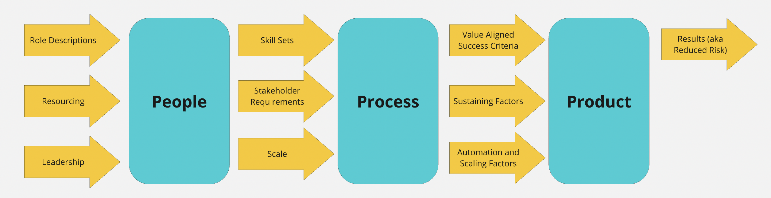

Slide 7

Agenda
Doing – Efficient Process
Deliverables – Effective Outcomes
Done – Value Maximized
THIS WAY

Slide 8
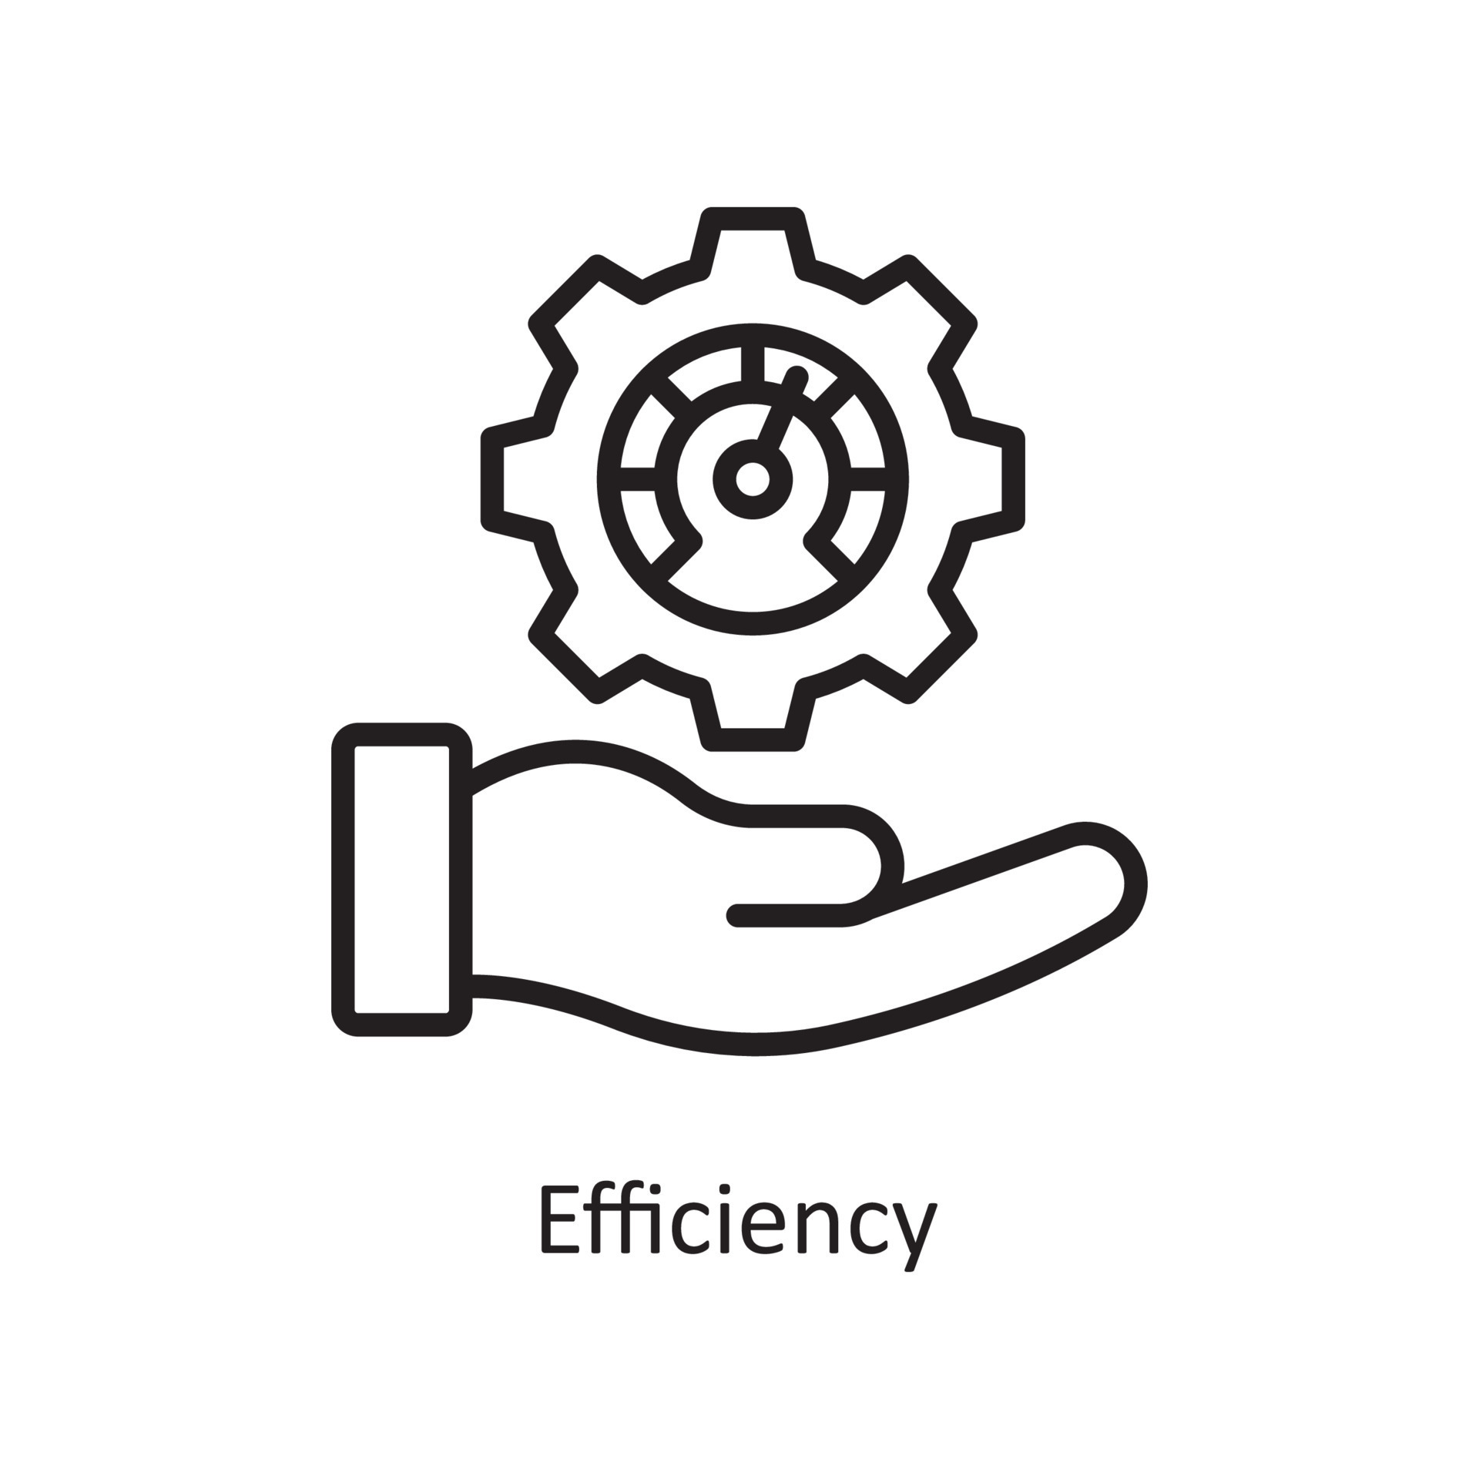
DOING – EFFICIENT THREAT MODELING
An efficient process is defined as a procedure or series of actions that achieves its intended outcome with the least amount of wasted resources, such as time, money, energy, or materials.

Slide 9

Rented Security Budget
Security Stewardship
Demonstrate a strong ROI (pre-defined factors, culture-aligned behaviors, and process)
Demonstrate a need for further investment by transitioning from passive program management to active program management
Notes:
Security Stewardship
We need to earn our right to keep the budget we have
ROI focused helps us defend the spend
Pre-defined variables for ROI
Threat Modeling “The Process”
Threat Modeling “The Product”
Threat Modeling “The People”

Slide 10

HIGH ROI Threat Modeling Behaviors
Tight Scope Definition
Template-based threat modeling
3 Tier Threat Modeling (Env, Arch, Functional)
Prioritized Threats & Threats
Value Add Reporting
Notes:
Transition – AND again, depending on the size of your organization and the requirements, scale may need to be a considerable consideration. Earlier we asked the question will it scale and it’s a good question. Many processes and models work well in isolation but not at scale. I like to trade the stock market and I have been pretty good at it. I am really good at finding a couple mispriced stocks and just loading up in waiting but I am confident that If I needed to do that every single day, I would be broke with the number of trades I would lose money on.

Slide 11
Achieving Scalable Returns (using the TMM Capabilities)
Education
Building a team of security champions/evangelists
Active Practice
Creating Threat Models
Format Consistency
Pattern Cataloging
Tool Assisted Process
Action on Threat Models
Definition of Done
Baseline Improvement
Risk Management
Program Management
Value-Driven Management

Slide 12

HOW IMPORTANT IS EFFICIENCY WITHOUT EFFECTIVENESS?

Slide 13
DELIVERABLES – EFFECTIVE THREAT MODELING
Effective Threat Modeling Defined
Threat Modeling is a proactive assessment of risk which starts with a well scoped description of change and results in a prioritized list of realistic threats and a prioritized set of cost-effective mitigations with a timeline and plan for risk reduction.

Slide 14
What does effective threat modeling look like?
Organization Effectiveness vs Industry Effectiveness
Scaled to the organization
Value Aligned Change Scope
Realistic and Prioritized Threats aligned to org appetite
Prioritized Risk Reduction Plan of Action + Milestones
Notes:
Effective might look different from organization to organization
But will it scale
My focus is on translating existing business processes into a threat modeling tool
A difficult question is “What do other organization’s do?” is a difficult question because it changes for each industry or process level
Different compliance requirements generate variable levels of effectiveness metrics
Effectiveness requirements can create drag for efficiency if not value aligned

Slide 15

Notes:
3 Factor influence a child’s ability to enjoy a roadtrip
Height and the ability to see out the window
Distraction (reading, tablets, games)
Physical wellness (the ability to not be sick)
Emotional Wellness (the ability to sustain boredom)
What do you do with a child that is too short to see out the window, has no understanding of time and distance, can’t read. You distract them.

Slide 16
Staged Threat Modeling
Security Impacting Focused
Realistic + Prioritized Threats
Risk based + cost effective + Prioritized Controls
Mission + Stakeholder Aligned
What are we working on?
What can go wrong?
What are we going to do about it?
Did we do a good job?
Threat Modeling
4 hours
4 hours
12 hours
1 hour

Slide 17
What is VALUE
Stakeholder Aligned
Who are we threat modeling for?
What are their needs?
Why are those needs?
Mission Aligned
Why are we threat modeling?
What are the actual requirements?
Why do those requirements exist?
If we cannot answer WHY with substance, we should actively encourage teams to question process and requirements and drive to value

Slide 18
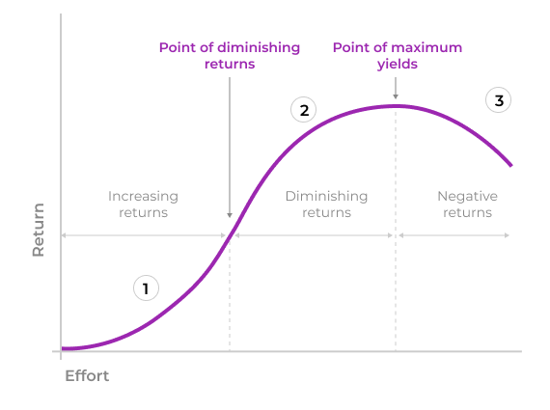
Diminished Marginal Returns
As the effort to create value (net return) increases the net value of the return is diminished over time
Notes:
Another example of this would be my stick figure drawing

Slide 19
Diminished Marginal Returns
As the effort to create value (net return) increases the net value of the return is diminished over time
Way to Accurate
Full Change Representation
Net Security Change

Slide 20
IN CLOSING
DOING – Efficient Threat Modeling
DELIVERABLES – Effective Threat Modeling
DONE – Maximum Value
ARE WE THERE YET?

Slide 21

QUESTIONS?

Slide 22
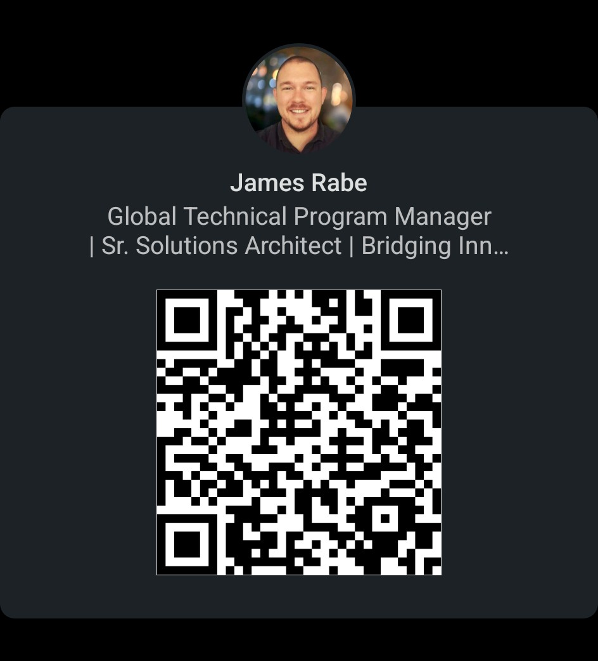

Connect
James Rabe
linkedin/in/jrabe3

